Slide 1
Bike-Share Systems
Justine Kojo
To be presented to Prof. Xiaodong Qian

Slide 2
Agenda
Background on Bike Sharing
Data
Temporal Analyses
Spatial Analyses
Other Data and supporting papers

Slide 3


Bike Sharing
Bike share systems are a form of public transportation that provides bicycles for short-term use to riders. These systems typically consist of a fleet of bicycles and docking stations located in public areas throughout a city.
In this system, a person can rent a bicycle from one station ride it towards his destination and then return it to a different station close to his destination. This concept makes transport much more convenient and accessible.

Slide 4
Bike Sharing
Since 2013, Citi Bike is a bike-sharing system in New York City that operates in partnership with the Department of Transportation.
With over 12,000 bikes and 800 docking stations. Citi Bike provides riders with a convenient and eco-friendly way to travel short distances within the city, making it a popular choice for commuting and sightseeing.

Slide 5
Data
Trip Data

Slide 6
Data Source
So, the data source for the various analyses on this assignment is going to be based on the citi-bike system’s trip data download from their website (https://s3.amazonaws.com/tripdata). This website does not require authentication before download, so it was easy to automate a python script to download and extract the trip data from the website.

Slide 7
Data Cleaning
The trip data downloaded was to a large extent organized except for the inconsistent data gathered in January 2021 which was separated from the rest of the data.
The other kinds of processing that was done included;
Data type conversion: I had to convert the date columns from string formats to date-time formats and numeric types
Removal of empty records: some of the months contained null records or null cells, latitude and longitude values with missing data.

Slide 8
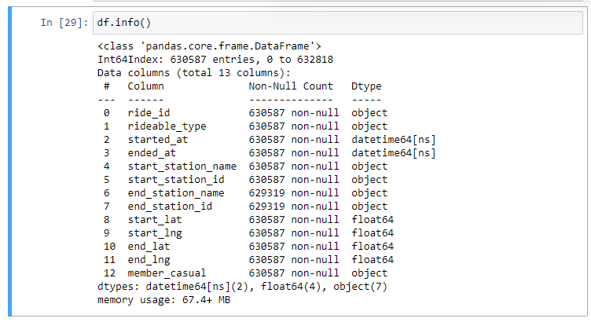
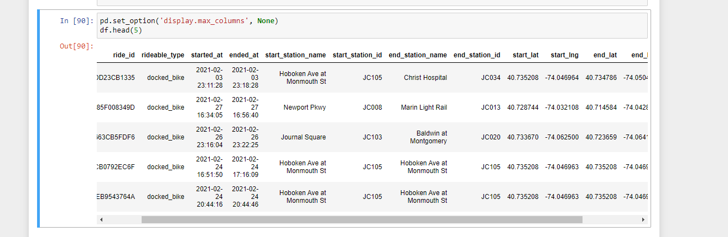
Data Snippets

Slide 9
Temporal Analyses
Trip Data

Slide 10
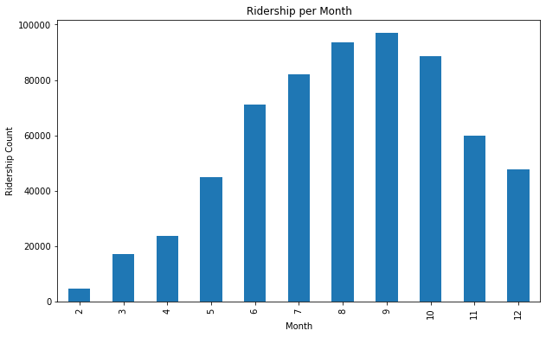
Ridership per month for 2021
This shows that ridership started low at the beginning of the year, peaked in September at a ridership of about 9,9000 rides that month then started dropping as the year was ending. It is likely that the weather played a role in the fluctuation of ridership per month.
In New York, September is usually considered to have warm and pleasant weather, which could have contributed to the high ridership in that month. On the other hand, the drop in ridership towards the end of the year could be due to the cold and harsh winter weather, leading to fewer people opting for bike rides.

Slide 11
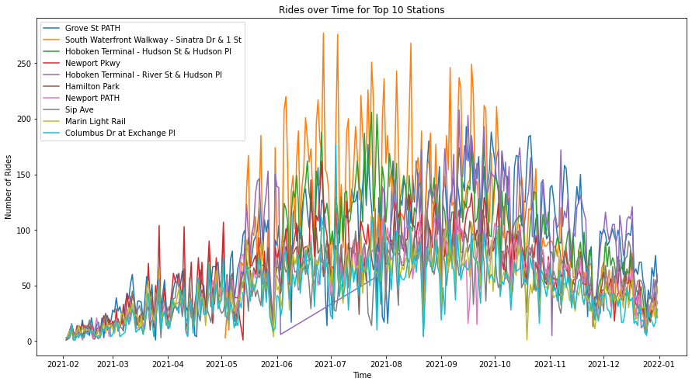
Generally, the late spring and summer seasons from May to September with temperatures are warm are considered the best for riding in New York. The graph above clearly follows the general pattern of the seasons.

Slide 12
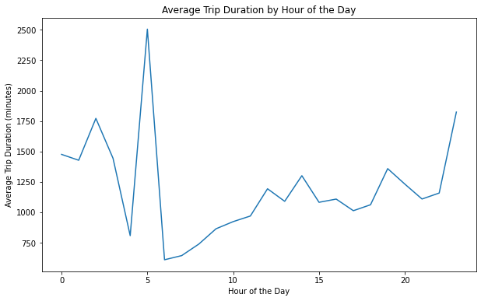
Average Trip Duration by Hour of the Day
The longest trips are taken in the morning between 4 and 6am. Although most users might be asleep by then, the longest activities are occurring in this period as well including parts of the late night. This suggest that the trips are taken for physical training purposes.

Slide 13
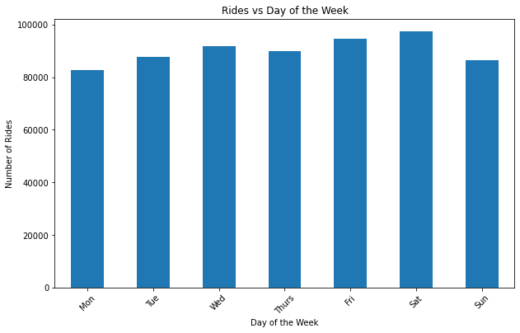
Number of Rides Per Day of Week
Most rides occur towards the weekends peaking on Saturdays. This could be because most people are generally free from work and can therefore take casual rides during the weekends.

Slide 14
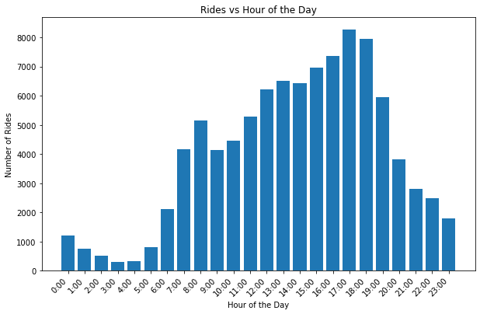
Rides vs. Hour of the Day
There are relatively little activities between 12am and 5am. However, after that period (which is mostly when people get out of their homes) there is a growing ridership peaking at around 6pm when people are likely to be commuting to and from work or engaging in other activities outside their homes. After this peak, the ridership starts to decline and reaches its lowest point at 11pm, likely because people have completed their activities and are returning home.

Slide 15
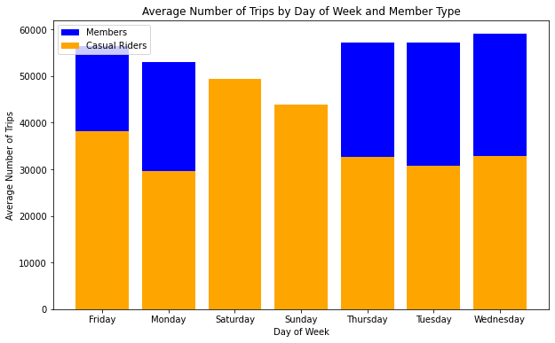
Average Number of Trips by Day of Week and Member Types
The graph confirms that all the members who use the system during the weekends are mostly casual members. Most likely for fun or for physical training purposes.

Slide 16
Spatial Analyses
Trip Data

Slide 17
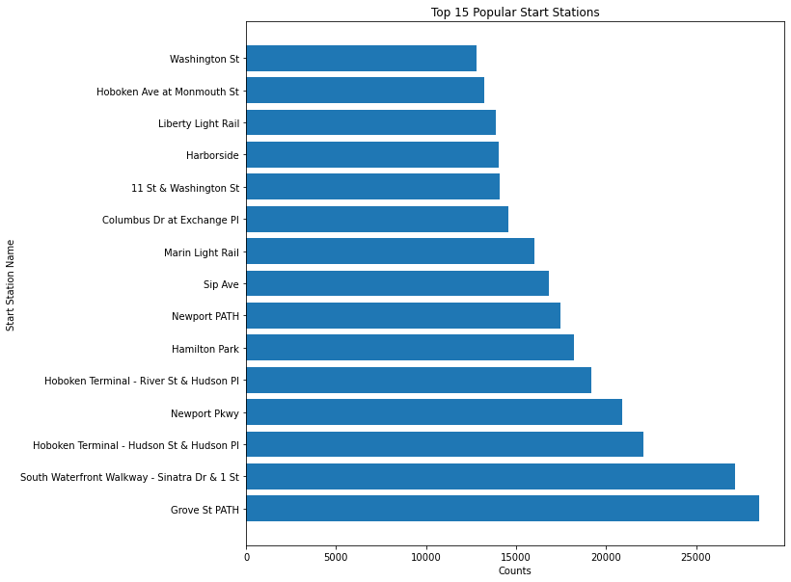
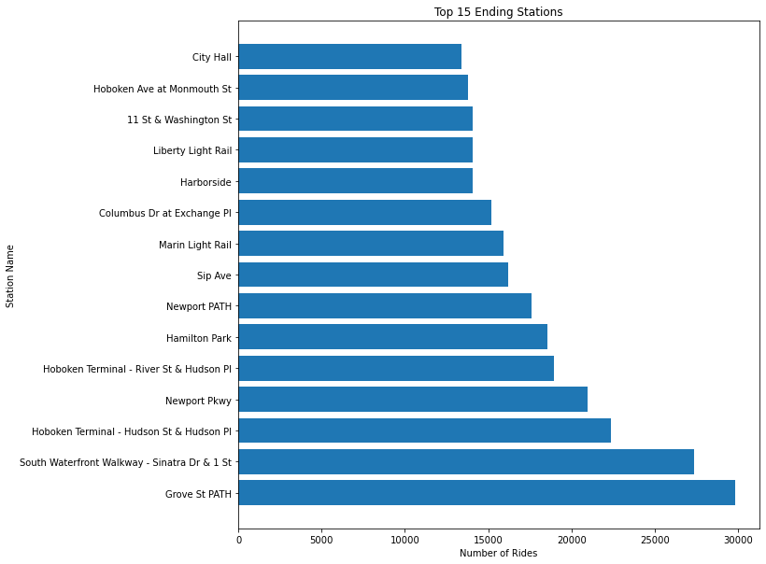
Top 15 Most Popular Routes

Slide 18
Average Number of Trips by Day of Week and Member Types
Considering the previous two graphs, the most popular start stations shows that Grove St. Path station was the most frequently used, with a high number of rides originating from that station.
The graph for popular end stations shows that the second most popular station was South Waterfront Walkway to Dr & 1 St.
This information can be used to optimize resources and infrastructure in these areas, to ensure a safe and efficient riding experience for users. It can also help to identify areas for improvement, by identifying underutilized stations/routes such as Washington St. and City Hall St. that may benefit from increased investment or promotion.

Slide 19
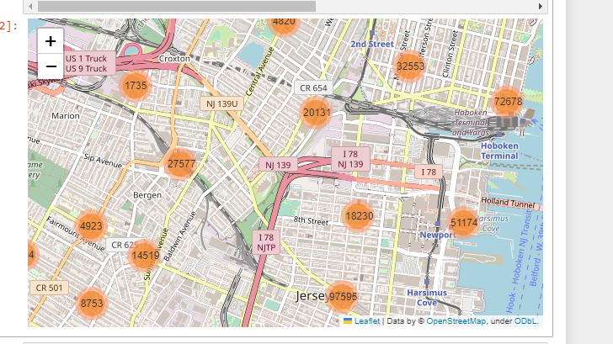
Areas with ride activities
The clusters are represented by a color, and the size of the cluster reflects the number of unique rides that occurred in that area.
This information provides valuable insight into where riders are frequently starting and ending their trips and can inform decisions related to bike station placement, infrastructure development, and policy making. For example, areas with high ride activity may warrant the expansion of bike lanes or the creation of bike-friendly streets to accommodate the growing demand for bike riding in the city.

Slide 20
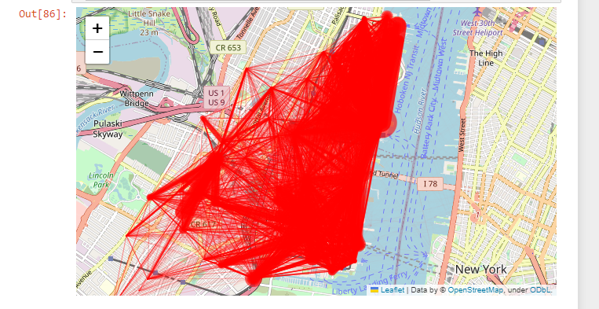
Origin- Destination Lines

Slide 21
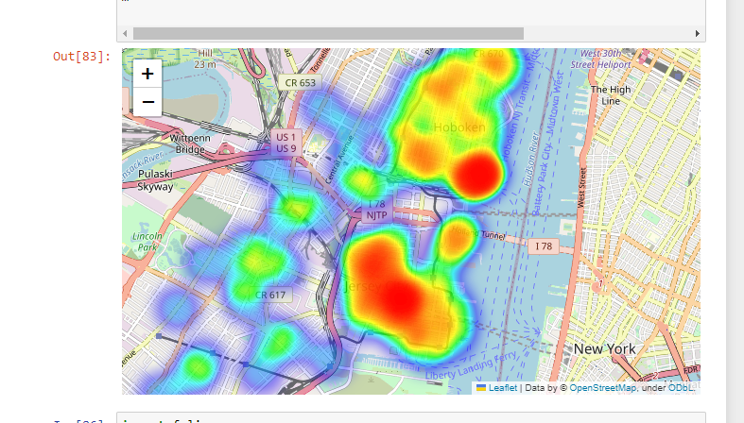
Hotspot areas/routes for riding
The map displays clusters of points, each representing the number of unique rides that took place in that specific area.
This information can be valuable for policymakers, bike rental companies, and other stakeholders who are interested in improving the bike-riding experience for users.

Slide 22
Other Data Sources
And Papers

Slide 23
Other Data That May Help to Give a Better Interpretation and Prediction of Trips
To predict bikeshare trip activities, some relevant data sources include:
Weather data such as temperature, precipitation, and wind speed: This can be obtained from weather agencies such as National Weather Service (NWS) or National Oceanic and Atmospheric Administration (NOAA).
Demographic data such as population density and income levels: This can be obtained from the US Census Bureau or other demographic research organizations, also, data can be downloaded from worldpop.com
Economic data: This can be obtained from the Bureau of Labor Statistics or other economic research organizations.
Land use and Land Cover Information: Which can be either be downloaded from the NASA website or determined using GIS and Remote Sensing Technologies.
Transportation data: This can be obtained from transportation agencies such as the Federal Highway Administration or the Department of Transportation

Slide 24
Supporting Research Papers
In a research Article titled; Effects of built environment and weather on bike sharing demand: a station level analysis of commercial bike sharing in Toronto authored by El-Assi et al. (2017); The paper explores the relationship between the built environment and weather conditions and their effect on bike-sharing demand in Toronto, Canada. At the end, the paper proposes that the demand for bike-sharing is significantly influenced by characteristics including land use, population density, and accessibility to public transportation, as well as by meteorological conditions, particularly temperature and precipitation. Generally, the study emphasized on the need of taking the built environment and weather into account when designing bike-sharing systems.
The paper "Investigation on the effects of weather and calendar events on bike-sharing according to the trip patterns of bike rentals of stations" by Kim (2018) aimed to investigate the impact of weather and calendar events on bike-sharing demand. The study analyzed the trip patterns of bike rentals of stations in South Korea to determine the effects of weather and calendar events on bike-sharing. The results showed that weather conditions, such as temperature and precipitation, have a significant impact on bike-sharing demand. Additionally, the study found that calendar events, such as holidays and weekends, also have a significant effect on bike-sharing demand. Therefore, findings of this study support the conclusion that weather and calendar events play a crucial role in determining bike-sharing demand.
Considering a paper authored by Wang & Lindsey, (2019) titled; “Neighborhood socio-demographic characteristics and bike share member patterns of use”. After adjusting for station accessibility, adjacent bike infrastructure, the built environment, gender, and age, the results show that participants use bike share more frequently in neighborhoods with a higher concentration of minorities and lower socioeconomic status (SES) neighborhoods. These passengers travel at more varying hours of the day and on more days of the week, and they use more origin-destination pairs of stations regularly.

Slide 25


Clarifications & Disclosure
The code (jupyter notebook) and a detailed write up will be attached along with this PPT.
I must clearly mention that; most of the code I used for my analysis was not written off head. I had to research, watch YouTube videos, ask questions etc. In order to get some parts of codes to work.
I think GIS tools such as QGIS or ArcGIS could also be used to perform spatial analysis and also to map out the result of these analyses

Slide 26
Thank you
Justine Kojo
awumboro@gmail.com

